Slide 1
Stock Report

Slide 2
TSLA: 2018-07-20 to 2018-08-10

Slide 3
Summary
TSLA closed down at 352.45 dollars per share on 2018-08-10.
High: 367.01
Low: 345.73
Close: 352.45
Notes:
Data were analyzed using these packages:
tidyquant
quantmod
tidyverse

Slide 4
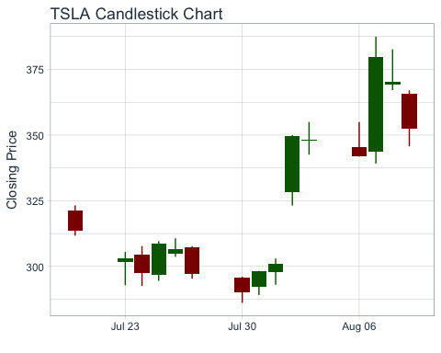
Price History
Stock prices for TSLA

Slide 5
TSLA last week
date | open | high | low | close
2018-08-01 | 297.99 | 303.00 | 293.00 | 300.84
2018-08-02 | 328.44 | 349.99 | 323.16 | 349.54
2018-08-03 | 347.81 | 355.00 | 342.53 | 348.17
2018-08-06 | 345.46 | 354.98 | 341.82 | 341.99
2018-08-07 | 343.84 | 387.46 | 339.15 | 379.57
2018-08-08 | 369.09 | 382.64 | 367.12 | 370.34
2018-08-09 | 365.55 | 367.01 | 345.73 | 352.45

Slide 6
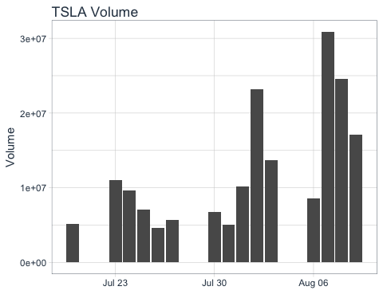
Volume
TSLA trading volume was 17,103,700 shares on 2018-08-10. Average trading volume over this time period was 12,210,800 shares.
Trading volume for TSLA

